Slide 1
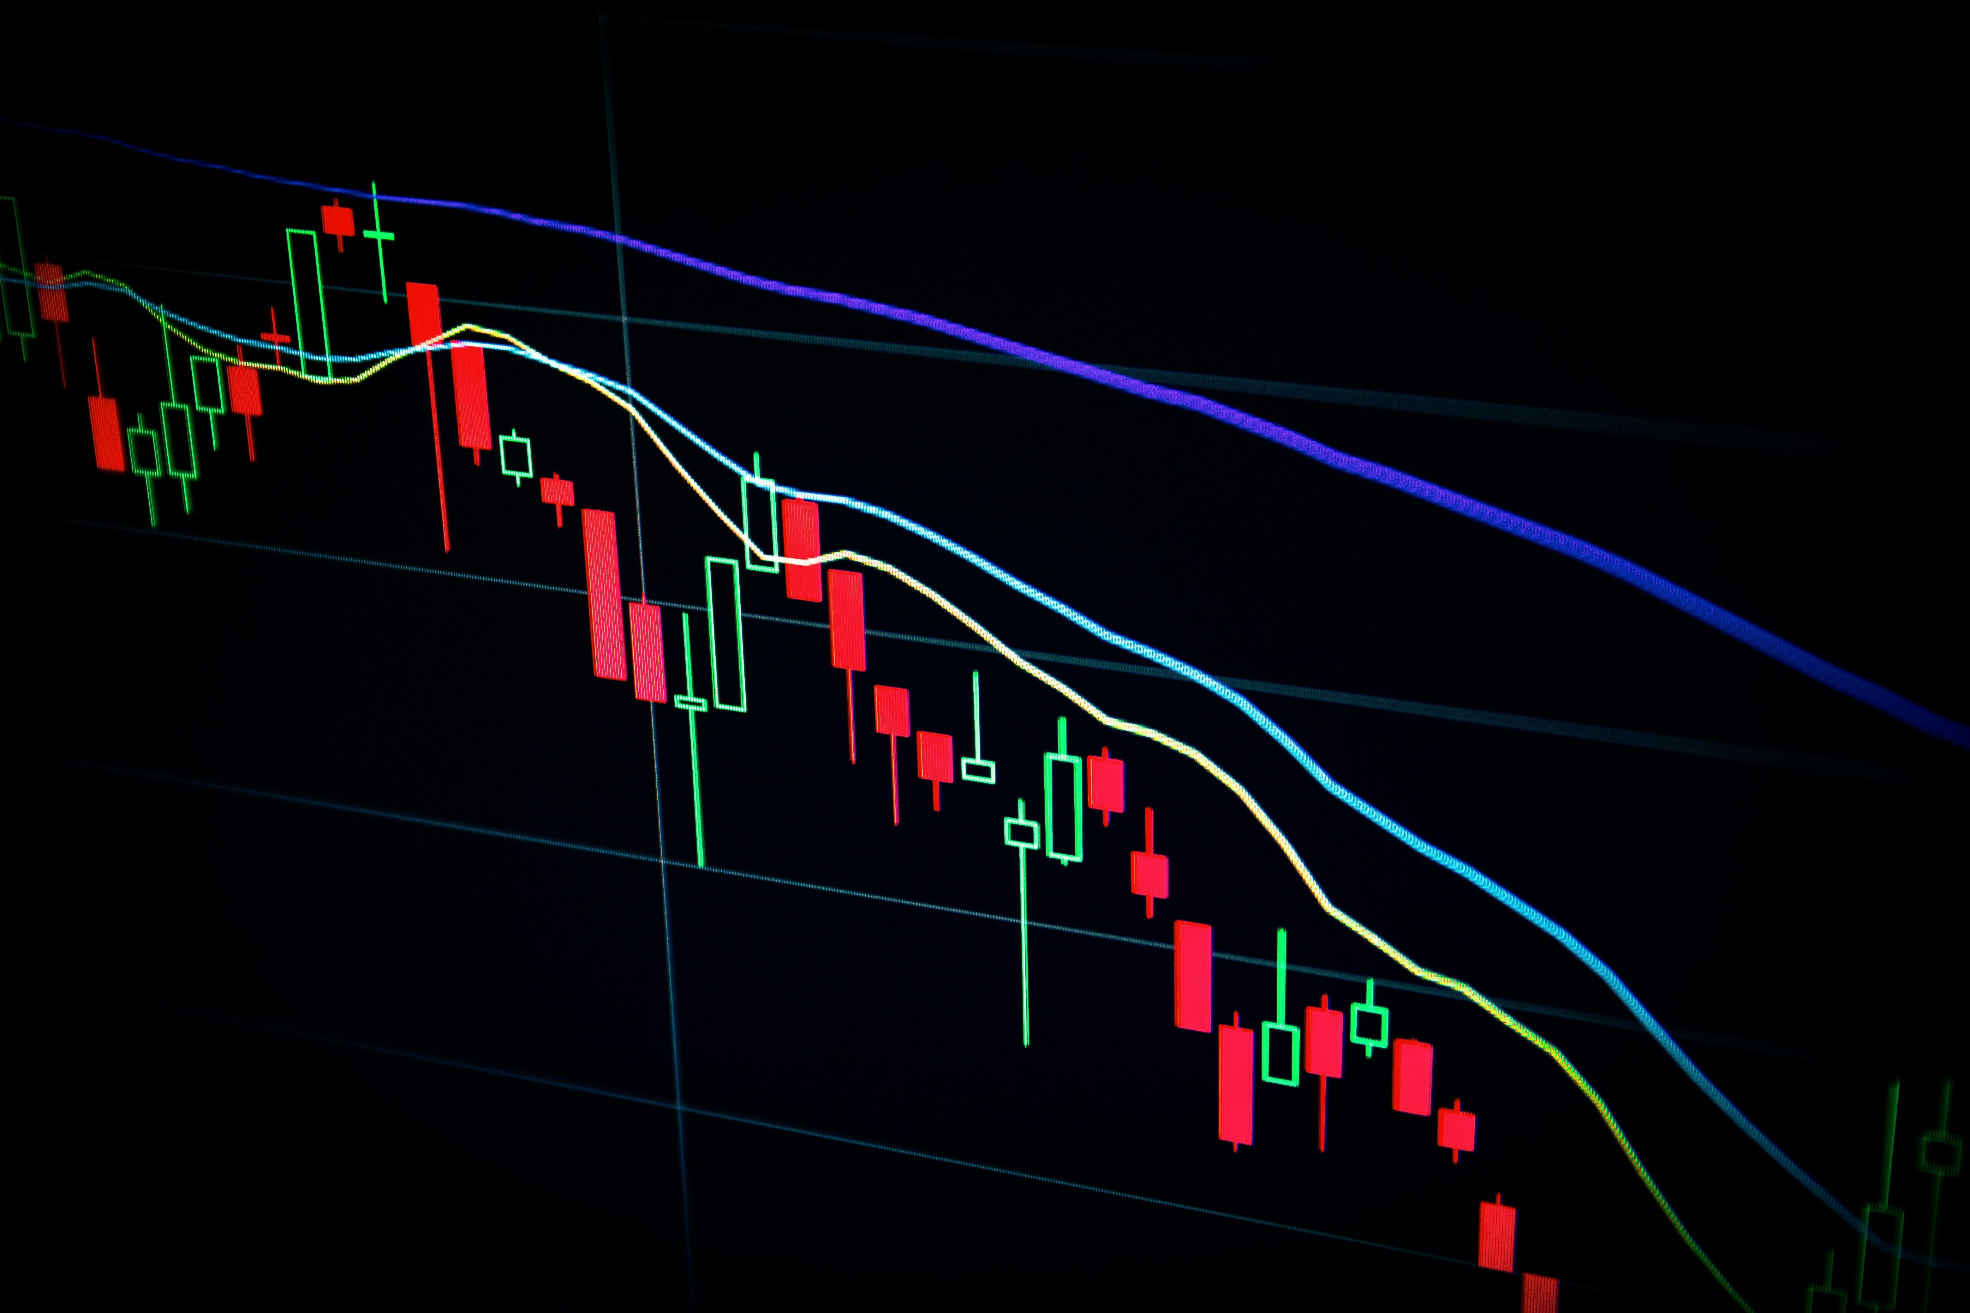


SENTIMATRICS AI
MID SEMESTER
DEFENSE
TEAM: SULAV TIMALSINA, SUSHANT POUDEL, SUSHIL UPADHYAY
SUPERVISIOR: ASST.PROF.KRISHNA BIKRAM SHAH
DATE: 06 MAY 2025

Slide 2

INTRODUCTION
WHAT IS SENTIMATRICS AI?
AI TO PREDICT NEPSE STOCK PRICES BY ANALYZING STOCK SENTIMENTS
WHY SENTIMENT ANALYSIS FOR NEPSE?
SOCIAL SENTIMENT INFLUENCES STOCK PRICES
EARLY DETECTION OF TRENDS AND EVENTS
EARLY DETECTION OF TRENDS AND EVENTS
MISSON & OBJECTIVE
CLASSIFY SOCIAL MEDIA AND NEWS SENTIMENTS AS POSITIVE, NEGATIVE, OR NEUTRAL.
CORRELATE SENTIMENT TRENDS WITH NEPSE STOCK PRICE MOVEMENTS.
FORECAST STOCK PRICES ACROSS DAILY HORIZONS WITH A PREDICTION ENGINE.
2

Slide 3

LITERATURE REVIEW
RELATED WORK
POSITIVE SENTIMENT BOOSTS VOLATILITY; NEGATIVE SENTIMENT STABILIZES.[1], [2]
TRANSFORMER MODELS (E.G., BERT) OUTPERFORM LEXICON-BASED ONES.[3]
ASPECT-BASED SENTIMENT ISOLATES STOCK-RELATED CONCERNS.[4]
IDENTIFIED GAPS IN RESEARCH
LACK OF FOCUS ON SMALLER MARKETS LIKE NEPSE.[6]
MINIMAL REAL-TIME SENTIMENT INTEGRATION IN MANY MODELS.[5],[9]
LEXICON METHODS OVERSIMPLIFY; TRANSFORMERS ARE RESOURCE-HEAVY.[3].
METHODOLOGIES USED IN PAST STUDIES
LEXICON-BASED METHODS (E.G., VADER) ARE SIMPLE BUT CONTEXT-LIMITED.[3]
ENSEMBLE METHODS (E.G., PROPHET + ML) IMPROVE ROBUSTNESS.[8]
DATA FROM SOCIAL MEDIA, NEWS, AND APIS VARY IN QUALITY AND DEPTH.[6],[7],[9]
3

Slide 4
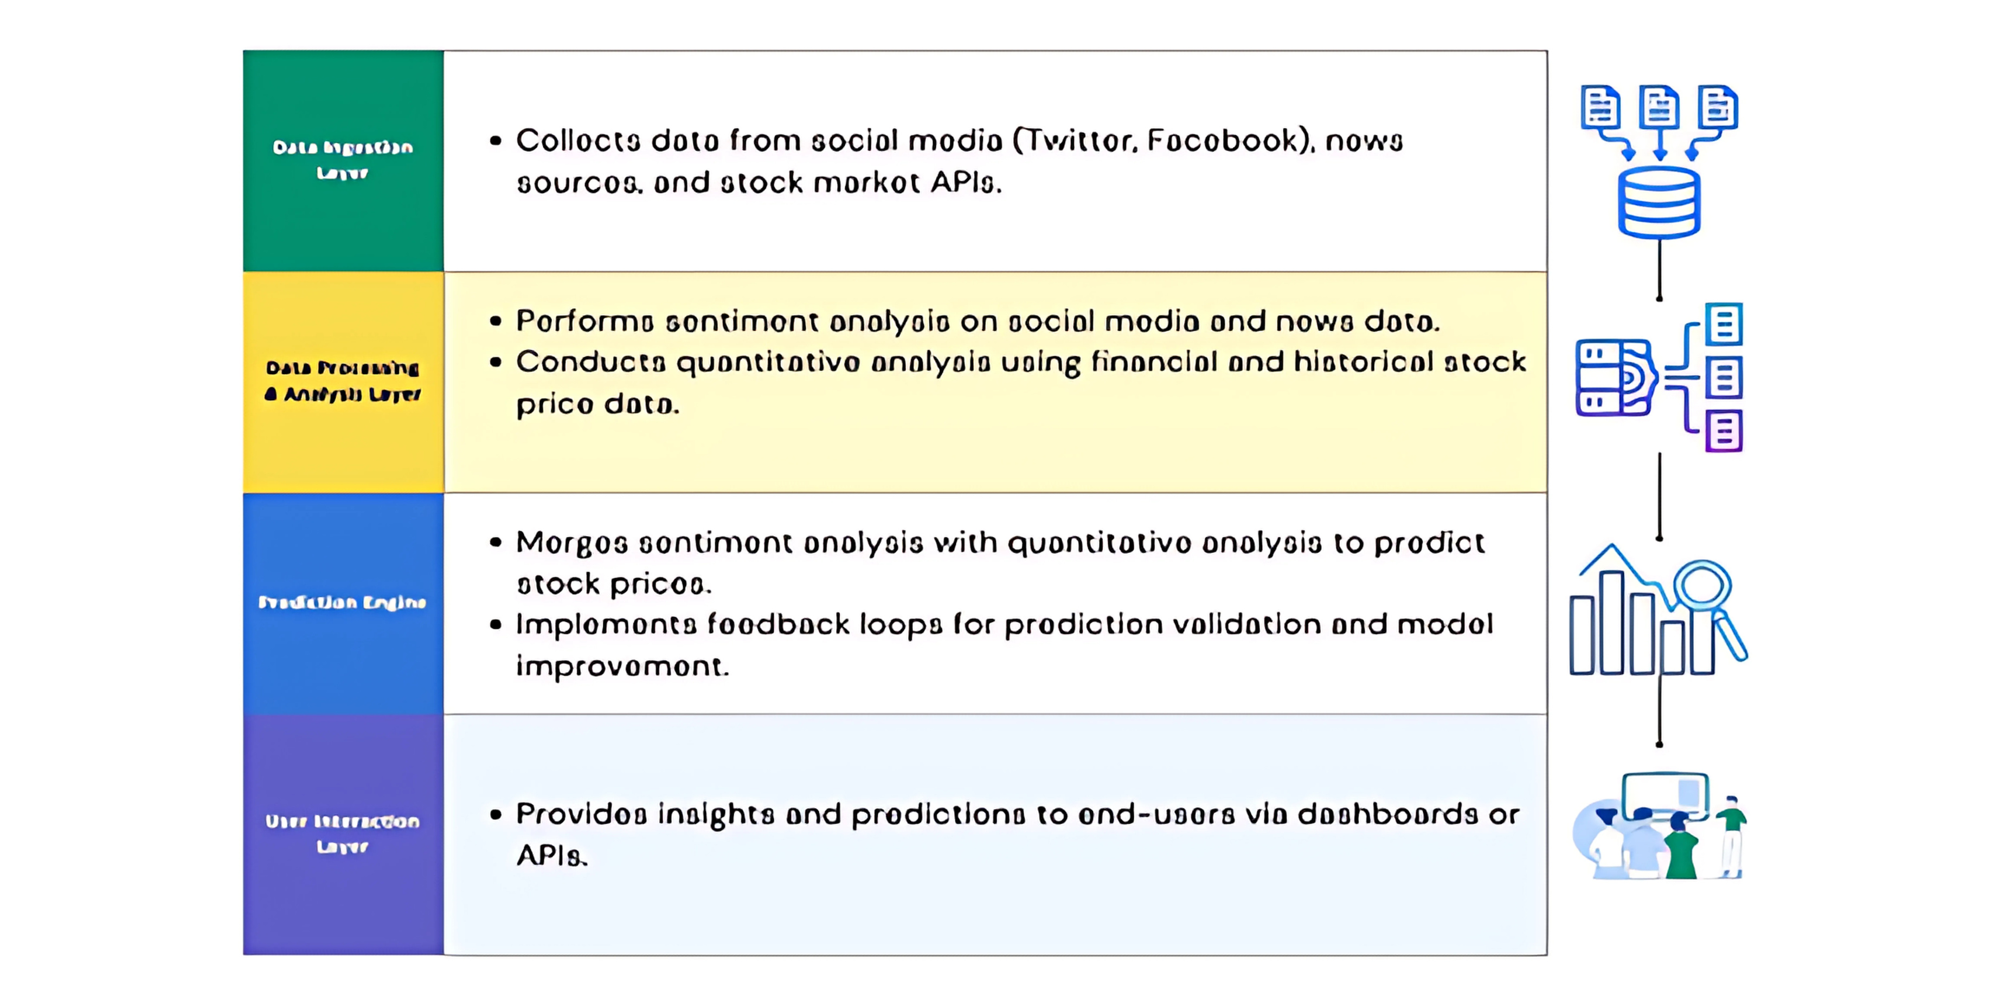
SYSTEM DESIGN
4

Slide 5
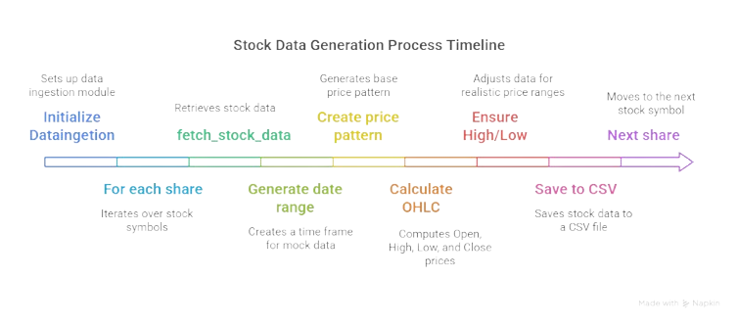
DATA INJECTION
5

Slide 6
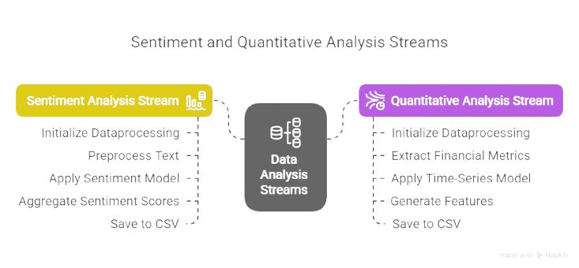
DATA PROCESSING LAYER
6

Slide 7
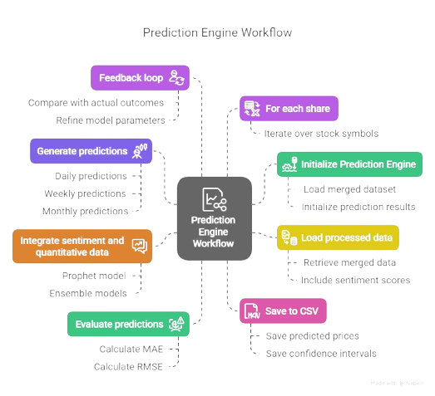
PREDICTION ENGINE
8
1
7
2
6
3
4
5
7

Slide 8
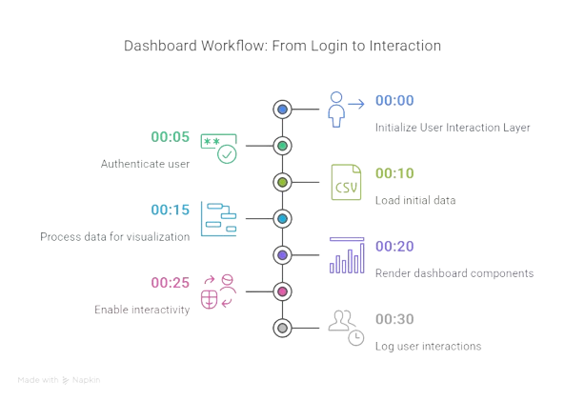
DASHBOARD
8

Slide 9

DEMO
9

Slide 10
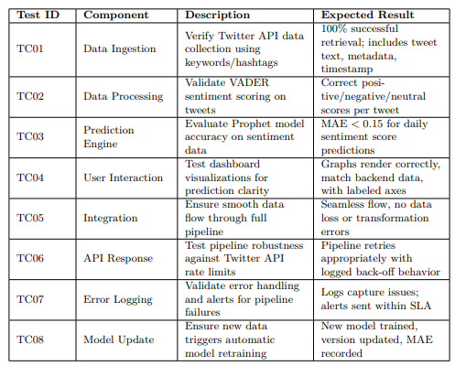
TESTING
10

Slide 11
FUTURE ENHANCEMENT
REAL-TIME DATA INTEGRATION
ENHANCED USER INTERFACE
FIVE MINUTE UPDATE
INTERGRATION OF TRUSTFULL NEWS OR TWEET SOURCE
PERCENTAGE OF WORK COMPLETE
REAL-TIME DATA INTEGRATION: 30%
WEIGHTED PROGRESS CALCULATION:
ENHANCED USER INTERFACE: 30%
REAL-TIME DATA INTEGRATION: 10% OF 30% = 0.1 * 30 = 3%
ENHANCED USER INTERFACE: 90% OF 30% = 0.9 * 30 = 27%
FIVE MINUTE UPDATE: 20%
FIVE MINUTE UPDATE: 50% OF 20% = 0.5 * 20 = 10%
INTEGRATION OF TRUSTFUL NEWS OR TWEET SOURCE: 20%
INTEGRATION OF TRUSTFUL NEWS OR TWEET SOURCE: 20% OF 20% = 0.2 * 20 = 4%
TOTAL PROGRESS: 3% + 27% + 10% + 4% = 44%
11

Slide 12
CONCLUSION
SENTIMETRICS AI SUCCESSFULLY DEMONSTRATES THE INTEGRATION OF SENTIMENT ANALYSIS AND QUANTITATIVE MODELING TO PREDICT NEPSE STOCK PRICES, MARKING A PIONEERING EFFORT IN NEPAL’S FINANCIAL SECTOR. THE SYSTEM’S MODULAR ARCHITECTURE, VALIDATED THROUGH TESTING, SUPPORTS REAL-TIME DATA PROCESSING AND USER-FRIENDLY VISUALIZATION VIA A REACT DASHBOARD. OUTPUT RESULTS SHOW PROMISING ACCURACY (MAE < 5)
12

Slide 13
REFERENCE:
1. GUO, Q. (2023). THE RELATIONSHIP BETWEEN INVESTOR SENTIMENT AND STOCK MARKET PRICE. FRONTIERS IN BUSINESS ECONOMICS AND MANAGEMENT, 9(2), 124–129.
2. HE, G., ZHU, S., & GU, H. (2020). THE NONLINEAR RELATIONSHIP BETWEEN INVESTOR SENTIMENT, STOCK RETURN, AND VOLATILITY. DISCRETE DYNAMICS IN NATURE AND SOCIETY, 2020, 1– 11.
3. MISHEV, K., GJORGJEVIKJ, A., VODENSKA, I., CHITKUSHEV, L., & TRAJANOV, D. (2020). EVALUATION OF SENTIMENT ANALYSIS IN FINANCE: FROM LEXICONS TO TRANSFORMERS. IEEE ACCESS, 8, 131– 147.
4. ONG, K., HEEVER, W., SATAPATHY, R., MENGALDO, G., & WANG, Z. (2023). FINXABSA: EXPLAINABLE FINANCE THROUGH ASPECTBASED SENTIMENT ANALYSIS. ARXIV PREPRINT, ARXIV:2307.12345.
5. SIGANOS, A., VAGENAS-NANOS, E., & VERWIJMEREN, P. (2017). DIVERGENCE OF SENTIMENT AND STOCK MARKET TRADING. JOURNAL OF BANKING & FINANCE, 78, 130–141.
6. GANDALF1819. (2024). STOCK MARKET SENTIMENT ANALYSIS. GITHUB REPOSITORY. RETRIEVED FROM HTTPS://GITHUB.COM/ GANDALF1819/STOCK-MARKET-SENTIMENT-ANALYSIS
[7] TETLOCK, P. C. (2007). GIVING CONTENT TO INVESTOR SENTIMENT: THE ROLE OF MEDIA IN THE STOCK MARKET. THE JOURNAL OF FINANCE, 62(3), 1139–1168.
[8] XING, F. Z., CAMBRIA, E., & WELSCH, R. E. (2018). NATURAL LANGUAGE BASED FINANCIAL FORECASTING: A SURVEY. ARTIFICIAL INTELLIGENCE REVIEW, 50(1), 49–73
[9] ZHANG, W., LI, X., & DENG, Y. (2018). SOCIAL MEDIA SENTIMENT AND STOCK MARKET: A LITERATURE REVIEW. INTERNATIONAL JOURNAL OF ECONOMICS AND FINANCE, 10(5), 1–12
13

